Slide 1
Chris Klug – Active Solution
ASP.NET Core Integration Testing 101

Slide 2
“
BATSHIT CRAZY
LIKE EVERYONE ELSE
Notes:
Hello everyone!
My name is Chris Klug, and a I work as a software developer/architect at a company called Active Solution in Stockholm…

Slide 3
Automated Testing

Slide 4
Why?

Slide 5
To Find Bugs!
Notes:
Sure, to find bugs is one reason…

Slide 6
Documentation
Notes:
This is a really good reason…but does it work? Well, it kind of does. But people don’t look at the tests to see how to use something, and how it works unfortunately

Slide 7
To be able to run parts of the application quickly
Notes:
Yes…so much this in my world!
But all of them have a purpose

Slide 8
Different tests for different reasons
Notes:
But we have different tests for different reasons…

Slide 9
Notes:
So…how many of you have seen this pyramid before, and know what text is being put into each layer?

Slide 10
E2E
Integration
Unit
Notes:
Yeah…end-to-end, integration and unit…
And the place in the pyramid is supposed to represent the amount of tests you should write…

Slide 11
Definition
Notes:
But before we get started, we kind of need to be on the same page of how we define the different types of tests…

Slide 12
…or my definition
Notes:
Or at least how I define them, so you understand where I’m coming from

Slide 13
Unit Test Tests the smallest part you can test, often class or method
Notes:
Or at least how I define them, so you understand where I’m coming from

Slide 14
Integration Test As soon as the test start testing multiple units/classes in combination
Notes:
Or at least how I define them, so you understand where I’m coming from

Slide 15
End-to-End Test Testing the whole system from one end to the other, such as UI/API to DB
Notes:
Or at least how I define them, so you understand where I’m coming from

Slide 16
E2E
Integration
Unit
Notes:
Ok, with that out of the world, we can carry on with a unified view of the different tests to mean
Or at least what I consider them to mean…

Slide 17
The problem with the test pyramid
Notes:
But there is a problem with the test pyramid in my opinion… And that’s the fact that…

Slide 18
E2E
Integration
Unit
Test Value
Notes:
I believe that the value of the tests are the inverse of the pyramid… Maybe not quite as aggressively inverse as this picture, but still, I think it is upside down…
E2E tests give us confidence that our app actually behaves like it is supposed to. Thus, hopefully verifying that the individual parts work as expected…
Sure, we might not get 100% test coverage. But we do get test coverage of the things we are using…

Slide 19
And why I think the value pyramid looks like this?
Notes:
Well…let’s ask the internet…

Slide 20
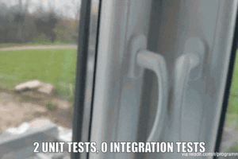

Slide 21
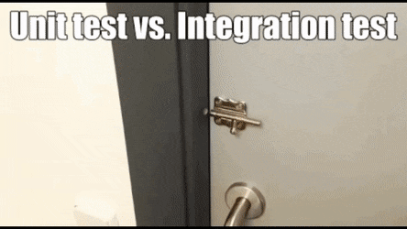

Slide 22
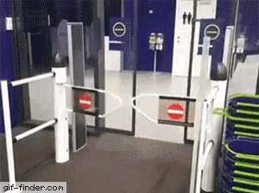

Slide 25
E2E
Integration
Unit
?
?
Notes:
So…why do we still having a pyramid that looks like this?
Well…because the entire picture often looks like…

Slide 26
E2E
Integration
Unit
Individual Test Size
Dev / Testing Cost
Notes:
This…
And sure…that doesn’t lie… The test size is smaller at the bottom, and easier to write…
Another version is this

Slide 27
E2E
Integration
Unit
Time to get feedback
Effort and Fragility
Notes:
This…
And sure, that isn’t wrong either…I guess… The larger the test, the more effort it takes to write… And it often takes longer to run as well, as there is more for the test to do…

Slide 28
E2E
Integration
Unit
Test Value
Notes:
But I still think we need to keep the value pyramid in mind as well…
Maybe the cost is warranted if the value is greater…
Especially as testing has changed a bit with new frameworks and new possibilities…

Slide 29
API Testing
Notes:
This talk is focused on API testing… And I’m not sure where in the pyramid you would put that to be honest…

Slide 30
E2E
Integration
Unit
Notes:
Is it integration testing…yes… So, it is above Unit testing…
But is it end-to-end testing? I’m not 100% sure of that… Yes, it does test that part of the system end-to-end. And if you are only building an API, I guess that is end-to end…
But if you have a UI on top of it, then it isn’t really end to end is it…
But that’s semantics I think…
I would say it ends up somewhere around here…at the top of integration testing and possibly bellow the end-to-end depending on how you look at it

Slide 31
But…wouldn’t that be slow and fragile?
Notes:
I don’t think so. With the tools we have at our disposal, the tests actually run fairly quickly…
They don’t feel that fragile as they don’t include UI testing and thus doesn’t include automating a browser using Cypress or Playwright for example…
This tests tend to be a bit more fragile as they often depend on browser automation as well as specific UI elements etc…

Slide 32
“Problems” to take into account
Notes:
I don’t think so. With the tools we have at our disposal, the tests actually run fairly quickly…
They don’t feel that fragile as they don’t include UI testing and thus doesn’t include automating a browser using Cypress or Playwright for example…
This tests tend to be a bit more fragile as they often depend on browser automation as well as specific UI elements etc…

Slide 33
Running tests without a special environment

Slide 34
Dependencies

Slide 35
Authentication

Slide 36
The database…
Notes:
And obviously the database… It is always the biggest problem when doing integration testing…
But I also believe that we should not be mocking out the database access, as that is a really big part of our application in most cases. Not testing that would be dumb…

Slide 37
EF mapping tests
Notes:
I actually often even write specific tests to run through my EF mappings. This allows me to work on the mappings and quickly verify that they work properly…
Makes life a lot easier considering that the EF mapping syntax isn’t always that easy…
I won’t be showing that today, but I wanted to mention it as it makes my life a lot simpler…
Coming back to that idea of having tests to run specific parts of your application quickly…

Slide 38
DEMO
Notes:
Create new Aspire Application project
Show App Host set up
Show ApiService
- AddServiceDefaults
Show ServiceDefaults
Show Web
- Show AddHttpClient
Start app (F5)
Show endpoint and proxy URL

Slide 40
Thank you
For listening
https://bit.ly/aspnet-integration-testing-101
https://fearofoblivion.com
@Zerokoll
Notes:
Thank you all for listening!

