Slide 1
Paul Yuknewicz (@paulyuki99)
How we achieved EXTREME scale under the hood in Azure Functions

Slide 2
In today’s session
Types of scaling
HTTP Scaling
Azure Functions Flex Consumption internal architecture
Messaging Scaling
Demos! Diagrams!

Slide 3
Types of scaling
2048 MB
Instance
4096 MB Instance
Scaling up
Aka vertical scaling
Instance sizes
Scaling out
Aka horizontal scaling
From zero to infinity to zero
Function App
Function App
Event Hub Function
Event Hub Function
Scale Controller
Event Hub Function
2 GB
Instance
2 GB
Instance
2 GB
Instance
2 GB
Instance
Function App
Function App
Function App
Function App
Event Hub Function
Event Hub Function
Event Hub Function
Event Hub Function
Notes:
Scale up
* Choose the memory of the instances needed for your executions and concurrency preferences
* More memory can handle heavier executions or have more concurrency depending on your workload
* CPU and bandwidth increases accordingly
Scale out
* Platform adjusts the number of instances based on incoming requests

Slide 4
Concurrency as the driver for scale
Per instance concurrency is the number of parallel requests handled by each instance
You control the concurrency, but we’ll provide defaults that work for most cases
Request 1
Request 1
Request 2
Instance size | Default Concurrency
512 | 4
2048 | 16
4096 | 32
*all Python | 1
10 HTTP Requests, concurrency = 1
Request 2
Request 3
10 HTTP Requests, concurrency = 2
Request 3
Request 4
Request 4
Request 5
Request 5
Request 6
Request 6
Request 7
Request 7
Request 8
Request 8
Request 9
Request 10
Request 9
Request 10

Slide 5
HTTP scaling - Previous approach
Antares instance
HTTP Requests
routed to front ends
Front Ends
1
2
Front ends ping
instances
Antares instance
LB
3
Scale decision
based on pings
Antares instance
Data Role
Azure SQL
4
Add or remove
instances

Slide 6
HTTP scaling
2
New logic based on
target concurrency per instance
Legion instance
Front Ends
New - Each instance supports a maximum number of concurrent requests (user configurable)
1
HTTP Requests
routed to front ends
Legion instance
LB
New batch API for acquiring instances backed by Cosmos DB
Legion instance
3
Cosmos DB
Data Role
4
New - Add or remove
instances in FPS backed by Legion with significantly larger compute allocation per app and rapid scale in + capacity reclamation

Slide 7
DEMO
Concurrency based HTTP scaling – command line
Notes:
plow https://func-techoramascaleu4rqaq2e5mygg-functions.azurewebsites.net/api/ProcessCustomerFeedback -c 500 --body @singlesamplecustomerfeedback.json -T 'application/json' -m POST -d 5m
Show local plow numbers
Open App Insights live metrics and show the instances and RPS
Query App Insights logs
requests
| where timestamp > ago(30m)// between (datetime('2024-09-30T00:33:00Z') .. datetime('2024-09-30T00:50:00Z'))
| summarize instance_count = dcount(cloud_RoleInstance) by bin(timestamp, 1s)
| render timechart

Slide 8
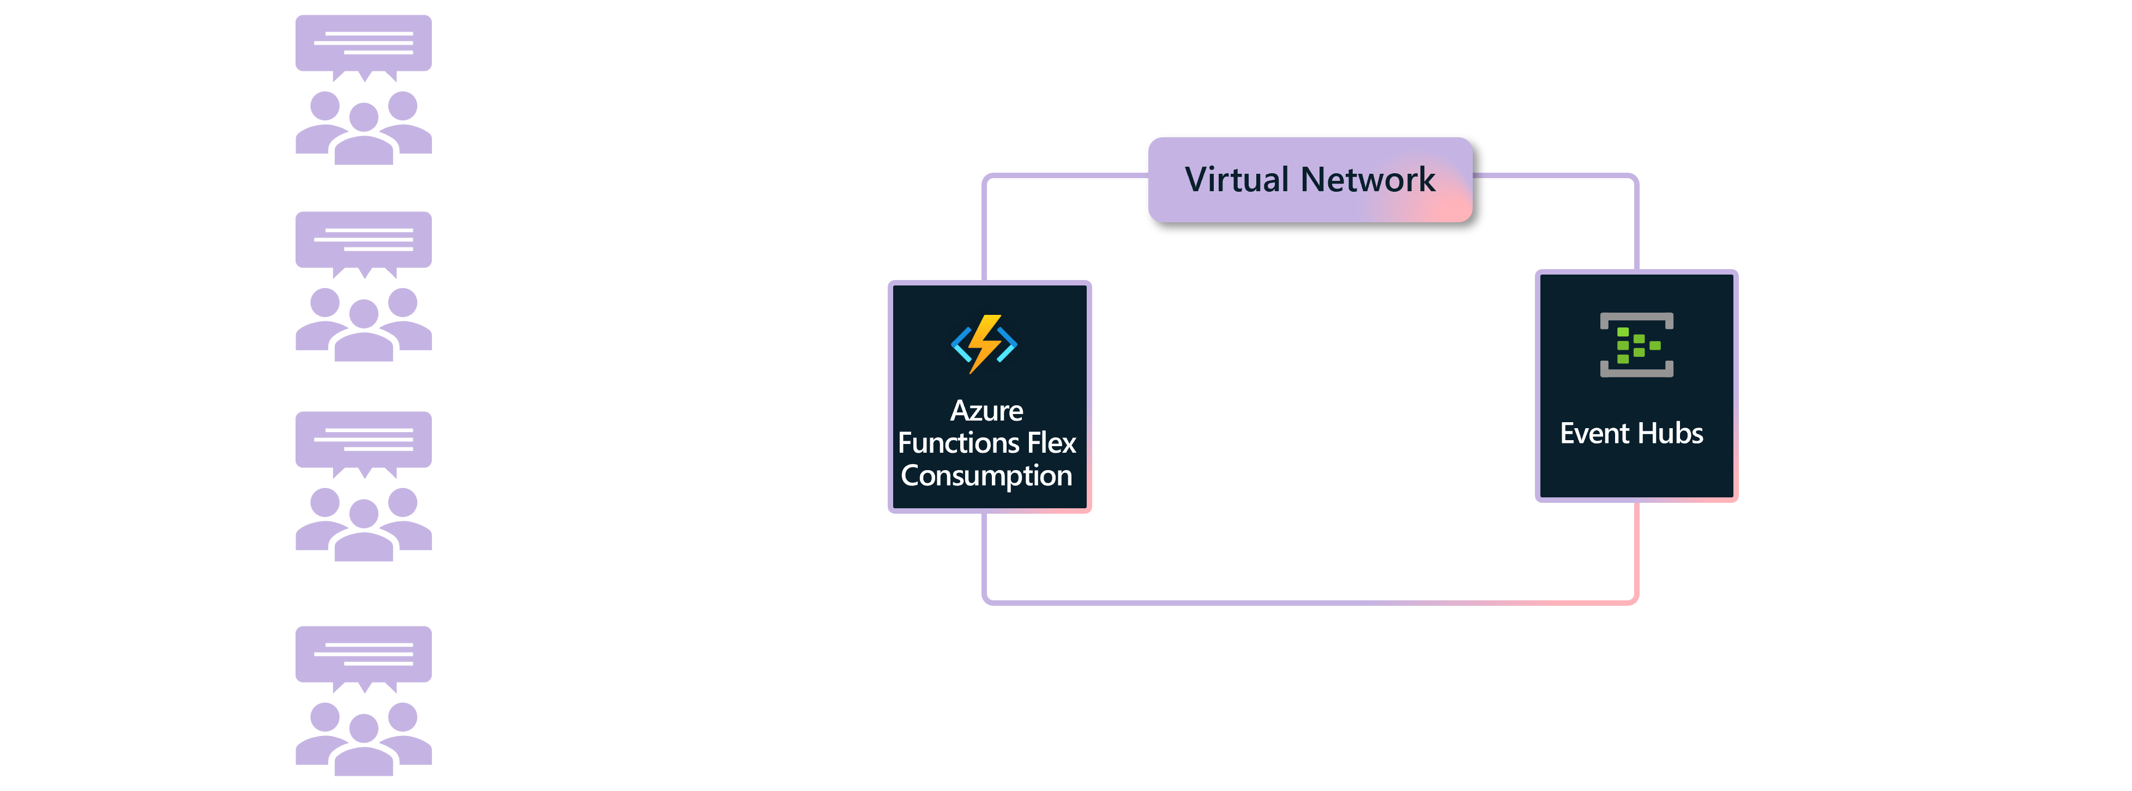
Test approach
Telemetry data ingestion Function App
Azure Load Test (1000+ RPS or 50k messages, 4 agents, 250 users each, POST json)
Flex Consumption defaults (Linux, 2048 GB)
Concurrency = 16 (messages per instance) .NET 8 isolated
HTTP trigger in; Event Hub message sending out
Optional: Event Hub trigger in a second function
KPIs: http request throughput RPS, event hub MPS, CPU
More info in ScaleLogs (app insights traces table)
telemetry
events
http post
transform
Flex E2E Samples -> EventHubs
https://aka.ms/flexsamples/

Slide 9
GitHub and Azure functions flex consumption
GitHub imports system telemetry using Event Hubs behind a VNet and publishes them over HTTPS
System scaled automatically and able to sustain ~1.6M messages processed per second with one Flex Consumption app
05:10
05:15
05:20
05:25
05:30
05:35
05:40
05:45
05:50
05:55
06:00
06:05

Slide 10
Project Legion
Backend for Flex Consumption, Container Apps Consumption workload profile, and Container Apps Dynamic Sessions
Design principles
Must be secured with Hyper-V isolation boundary
Must burst scale to 1000s of instances with VNET injection
Use latest Azure Security standards and reliability standards with Availability Zones support
Close feature parity with Kubernetes Pod API spec
Operate at a growing scale
Automate/optimize operational workstreams from day 0.
Specialized networking architecture
https://aka.ms/aca/project-legion-blog

Slide 11
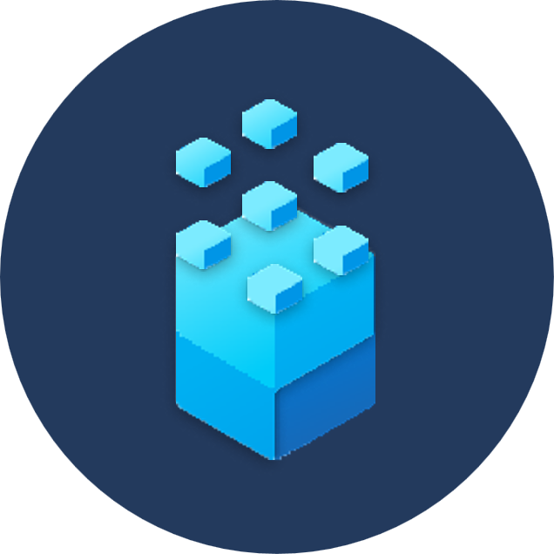
Legion high-level architecture
Container Apps
Legion Stamp
AKS Cluster
Centurion VM (VMSS)
Centurion VM (VMSS)
Virtual Kubelet
Nested VM
Nested VM
Nested VM
Nested VM
Legion Regional Control Plane
Container
Container
Container
Container
Legion
Regional Control Plane
Nested VM
Nested VM
Nested VM
Nested VM
Container
Container
Container
Container
Functions
Antares Stamp
Legion Stamp
Controller Role
Data Role
Legion Stamp

Slide 12
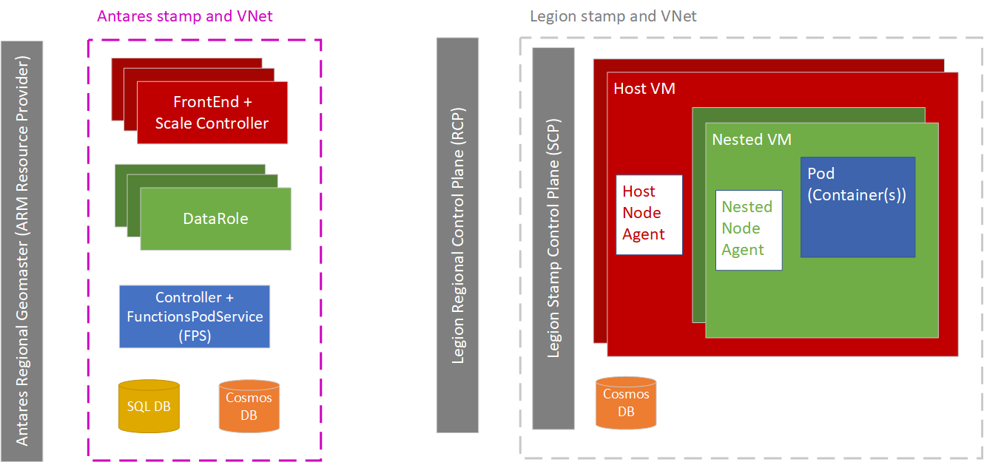
Flex internal services
Front End: processing and scale out of all HTTP requests to functions
Scale Controller: monitors and makes scaling decisions
Data Role: manages the lifecycle of workers
Controller: all control plane operations like create, start, stop
Function Pod Service (FPS): manages placeholder pool
Cosmos DB: new state store for Flex
Antares: compute infra for Web Apps
& Functions
Legion: container compute dispenser
Notes:
Front End: Responsible for processing of all HTTP requests both administrative as well from clients to Function apps. This component is responsible for scaling out Function Apps based on various factors like inbound load and concurrency. These run on the FrontEndRole which is a VMSS that scales out to increase the number of Front Ends based on load.
Scale Controller: This component runs within the FrontEndRole and monitors all non-HTTP trigger sources to make scaling decisions (both scale-out and scale-in). For HTTP triggers, it manages scale-in while the Front Ends manage scale-out.
Data Role: The component manages the lifecycle of workers (containers in Pods in the case of Flex Consumption). Based on the scaling needs indicated by the Front End and Scale Controller, it increases or decreases the number of workers allocated to each Function App.
Controller: Handles all control plane operations like Function App creation, start/stop etc.
Function Pod Service (FPS): This is a relatively new component added to manage the lifecycle of Functions workers. More specifically, it creates and maintains a pool of placeholder pods which are available to the Data Role to specialize when it needs to allocate workers to a Function App. FPS replinishes the pool by creating new placeholder pods. Flex consumption models the compute used to host workers along the lines of Kubernetes where a group of related containers is called a Pod. A pod contains a main container and one or more side-car containers where side-cars typicaly provide supporting functionality to the main container. In the case of Flex consumption, a placeholder pod contains two containers: the main container running the Functions host and a side-car container running the WorkerTokenServiceProvider that helps with Managed Identity related authentication. FPS has other responsibilities like creating and maintaining TriggerMonitor pods that help with scale to zero for VNet integrated apps as well other scenarios that can't be covered in detail in this overview.
SQL DB: This database is used in a typical fashion to other Functions SKUs.
Cosmos DB: This is a new addition to the Antares infrastructure to support Flex Consumption's rapid scaling needs. In addition to the SQL DB, state related to pod lifecycle and a few other scenarios is maintained here and accessed by ScaleController, DataRole and FPS components.

Slide 13
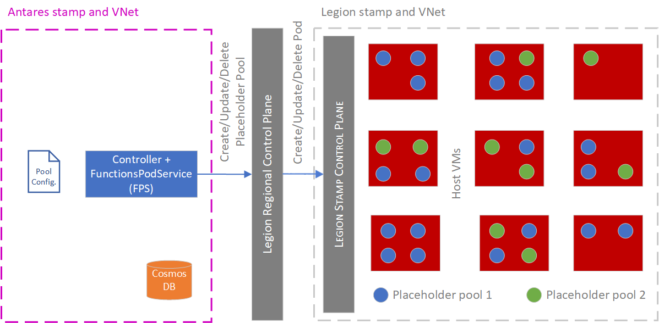
Placeholder pools
Pools provide abundant compute containers and reduce cold starts
Pools know about hardware sizes and hints about apps (e.g. JavaScript? .NET?)
In scale in, Data Role asks to drain, FPS disposes of containers that go idle

Slide 14
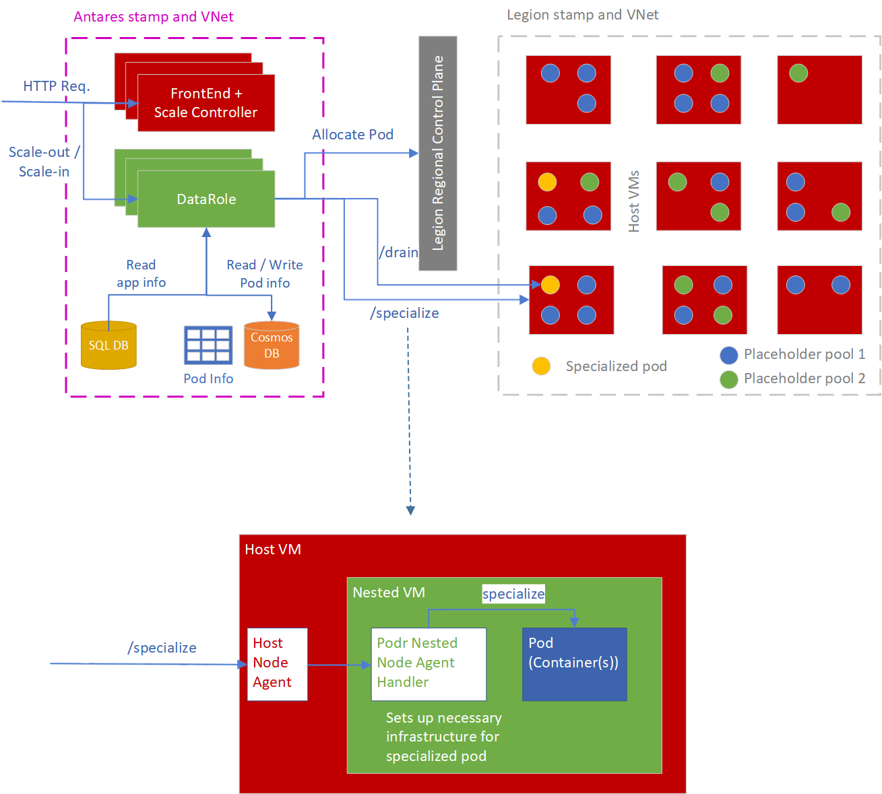
Specialization
Specialization applies your code to placeholders
Specialized pools can be scaled in regions
Node agents know about runtimes (e.g. .NET, Node) and how to side load app .zip
Now triggers are known and participate in scale monitoring (SyncTriggers success

Slide 15
Beyond one region for HTTP “follow the sun”
Sweden Central
North Europe
Global load balancing service (like Front Door)
Australia East

Slide 16
DEMO
Multi region
Notes:
plow https://func-techoramascaleu4rqaq2e5mygg-functions.azurewebsites.net/api/ProcessCustomerFeedback -c 500 --body @singlesamplecustomerfeedback.json -T 'application/json' -m POST -d 5m
Show local plow numbers
Open App Insights live metrics and show the instances and RPS
Query App Insights logs
requests
| where timestamp > ago(30m)// between (datetime('2024-09-30T00:33:00Z') .. datetime('2024-09-30T00:50:00Z'))
| summarize instance_count = dcount(cloud_RoleInstance) by bin(timestamp, 1s)
| render timechart

Slide 17
Concurrency based scaling for messages or event streams
Concurrency per instance is set to the default from the SDK or configured by you
Depth of the source message queue or last checkpoint of event stream is know
Platform decides number of required instances that the app needs
Evaluated frequently
Scales up and down fast with Flex Consumption
App instance 1
Seq no 743
App instance 2
Seq no 742
File Uploader
Seq no 744
Seq no 743
Seq no 742
Seq no 741
Seq no 740
App instance 3
Seq no 741
App instance 4
Seq no 740
https://learn.microsoft.com/en-us/azure/azure-functions/functions-target-based-scaling

Slide 18
Event or message based scaling
2
Scale controller determines target instance number based on event source and concurrency configuration
Legion instance
Scale Controller
Each instance supports a maximum number of concurrent requests (user configurable)
1
Scale Controller monitors event source
Legion instance
Event Source
Add or remove instances to match target instance number
Legion instance
3
Cosmos DB
Data Role
4
Add or remove
instances

Slide 19
DEMO
Concurrency based messaging scaling

Slide 20
Multiple functions in the same Consumption or Premium Plan app
Function App
Event Hub Function 1
Event Hub Function 1
Event Hub Function 2
Event Hub Function 3
Event Hub Function 2
Event Hub Function 4
maxEventBatchSize
Scale Controller
Event Hub Function 3
Function App
Event Hub Function 1
Event Hub Function 4
Event Hub Function 2
Event Hub Function 3
Event Hub Function 4
Target instance count is aggregated across all functions

Slide 21
Multiple functions in Flex Consumption
Event Hub Function 1
Event Hub Function 1
Event Hub Function 2
Scale Controller
Event Hub Function 2
maxEventBatchSize
Event Hub Function 3
Service Bus Function 3
maxConcurrentCalls
Service Bus Function 4
Event Hub Function 4
Each function has its own target instance count

Slide 22
Always Ready Instances
Optional always ready are instances that will be kept enabled and running for your app
Useful to ensure no cold start especially when there is a heavy or long warmup in your code
2 GB
2 GB
2 GB
2 GB
On demand
Load
2 GB
2 GB
2 GB
2 GB
2 GB
2 GB
2 GB
2 GB
2 GB
2 GB
2 GB
2 GB
2 GB
2 GB
2 GB
Always Ready
2 GB
2 GB
2 GB
2 GB
2 GB
2 GB
2 GB
2 GB
2 GB
Time

Slide 23
Networking
Close to networking feature parity with Elastic Premium and Dedicated plans
Serverless with full support for networking features at no extra cost
Regional VNet integration - outbound network access to services restricted by private and service endpoint
Inbound private and service endpoints
Azure Virtual Network
Function App
Service Bus
Cosmos DB

Slide 24
Changes in VNet configurations
Subnet must be delegated to Microsoft.App/environments
This means you must register Microsoft.App as a Resource Provider.
This means you cannot integrate Flex and non-Flex apps with the same subnet.
This means you cannot use the same subnets you were using for non-Flex VNet-integrations, even if you delete the non-Flex app you must remove the delegation first
Each Function app will consume at most 40 IP address (when scaled up the 1000 limit)
This means that a subnet size of /25 can sustain three Function apps at max scale, with only 3 “wasted” IPs (5 are consumed for infrastructure)
Only 37 milliseconds (ms) of overhead at the 50th percentile and 140 ms at the 90th
The site settings vnetRouteAllEnabled, vnetContentShareEnabled, vnetImagePullEnabled, vnetBackupRestoreEnabled are not used in Flex
This means you will be blocked by the Control Plane from setting these values; the UI to do so in the Portal is hidden.

Slide 25
How does scaling with networking in Flex Consumption differ from Premium/Dedicated?
Scaling decisions are typically done by our platform’s scale controller. However, it does not have access to reach resources network restricted in a customer’s VNet. Thus, it cannot monitor trigger sources restricted within the VNet!
Consumption
Premium/Dedicated
Flex Consumption
After scaling to 0, there is no vnet-injected Function app capable of checking on the trigger source.
There is always one instance injected into the customer vnet, which can monitor the trigger source.
This is called “Runtime driven scaling”
There will be a new, persistent component called the Trigger Monitor
The Function apps can scale to 0, while the Trigger Monitor persists to monitor the trigger source.

Slide 26
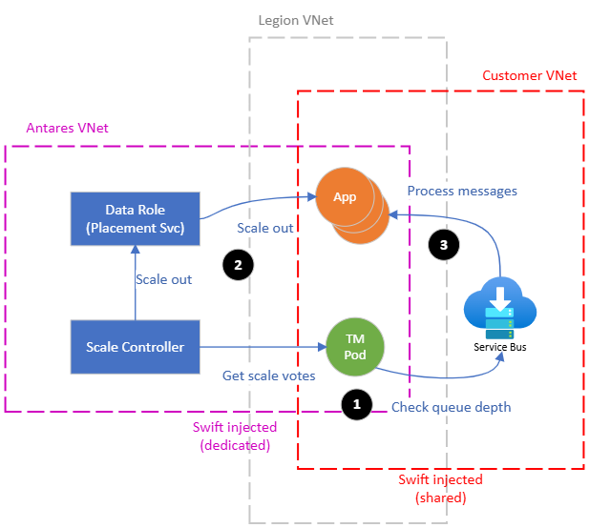
How did we build Networking scale into Flex?
STEPS
Scale Controller finds the Trigger Monitor associated with a Flex app.
Trigger Monitor accesses the trigger source and votes to scale in or scale out.
If scale-out, Scale Controller calls the Data Role to handle scale-out.
Data Role specializes an available placeholder pool.
The new instance now fetches messages.

Slide 27
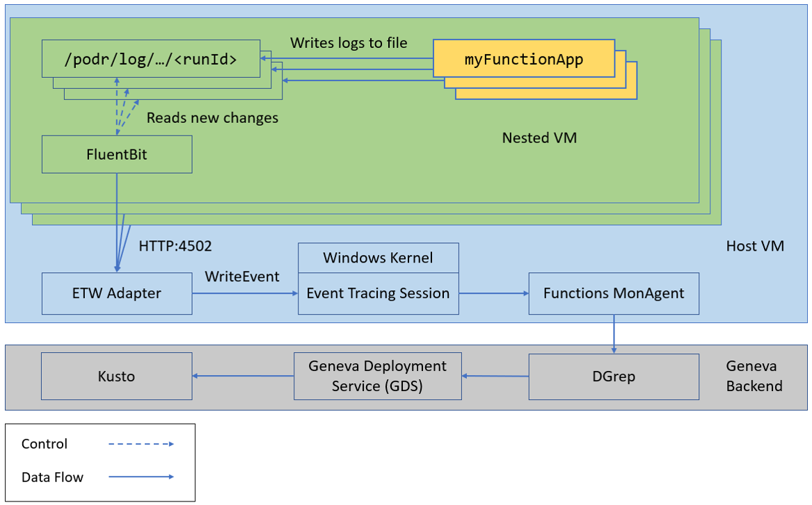
Logging at scale
Bottlenecks occur with single log files being written to and zipped
VM can be destroyed before log zip is shipped (“log truncation”)
Move to multiple log file screams with FluentBit
Notes:
Going more in-depth, the pipeline consists of the following components: | Component | Role | Owners | | :--- | :--- | :--- | | Podr | Writes container logs from the Functions host to files on the Nested VM. This component is part of the Nested Node Agent. | Legion | | FluentBit | Monitors the files Podr writes and forwards them to the ETW Adapter via HTTP. Optionally, FluentBit can parse individual log entries based on a configuration that the Functions team shares with other Legion customers. | Functions and Legion | | ETW Adapter | Takes logs (both parsed and unparsed) from FluentBit, parses them if necessary, and writes the resulting events to ETW (Event Tracing for Windows) via team-specific EventSources. | Functions and Legion | | Event Tracing Session | A component of the ETW pipeline, which is Windows's buffering and logging mechanism built into the kernel. | Windows OS | | MonAgent | Spins up team-specific monitoring sub-processes to read ETW events and send them to Geneva ingestion endpoints. | Functions and Legion | | DGrep | Persistent log storage. | Geneva | | Geneva Deployment Service (GDS) | Delivers logs from a configured source namespace (in Functions's case, FunctionsLegion for PROD and AzFuncLegion for TEST endpoints respectively) and eventType (e.g. FunctionsLogs, FunctionsMetrics, etc.) in DGrep to a configured Kusto destination (Antares Kusto) | Geneva | | Kusto | Log storage that supports fast queries. | Geneva |

Slide 28
Public Preview Regions and Runtimes
Regions
Runtimes
East US,
East US 2
South Central US
West US 2
West US 3
North Europe
Sweden South
UK South
Southeast Asia
East Asia,
Australia East
.NET 8 Isolated
Python 3.11
Python 3.10
Java 17
Java 11
Node 20 LTS
PowerShell 7.4 (Preview)
Notes:
West Europe*, Brazil South, Central India, Central US, UAE North, North Central US, West US under consideration

Slide 29
Roadmap (subject to change)
GA planned for November 2024
Post GA will bring extra features
512 instance size
Availability Zones support
Slots (zero downtime deployment)
Improved deployment with better observability and validation, and deployment slots
.NET 9 support

Slide 30
Resources
Public Preview https://aka.ms/flexconsumption/publicpreviewannouncement
Achieve high HTTP scale https://aka.ms/flexconsumption/httpscaleblog
Flex Consumption Documentation https://aka.ms/flexconsumption
Project Legion https://aka.ms/aca/project-legion-blog
Samples from demos https://aka.ms/flexconsumption/samples

